Slide 1


Data Governance @ SneakerPark
Prepared by: Vu Ngo
Submitted on: 20230525

Slide 2
Background
SneakerPark is an online shoe reseller that allows people to buy and sell used and new shoes. Buyers can bid for shoes or buy them outright, and sellers can set a price or sell to the highest bidder.
Each buyer and seller must have an active account in order to sell, bid, or purchase sneakers using SneakerPark’s website.
SneakerPark authenticates the shoes before shipping them to the buyer, so before listing an item, the seller must ship it to SneakerPark’s warehouse. Upon receipt, SneakerPark assigns an item number to each pair of sneakers and notifies the seller that they are now free to list their item. If the item is not listed within 45 days, SneakerPark returns it to the seller and sends an invoice to the seller for the shipping cost.
If the item is found to be inauthentic or in an unacceptable condition, it is also returned back to the seller in a similar fashion.
When the item sells, the buyer’s account is credited with the purchase price minus the SneakerPark service fee and shipping fees to deliver the item to the buyer.
Currently, SneakerPark only supports sales within the United States.

Slide 3
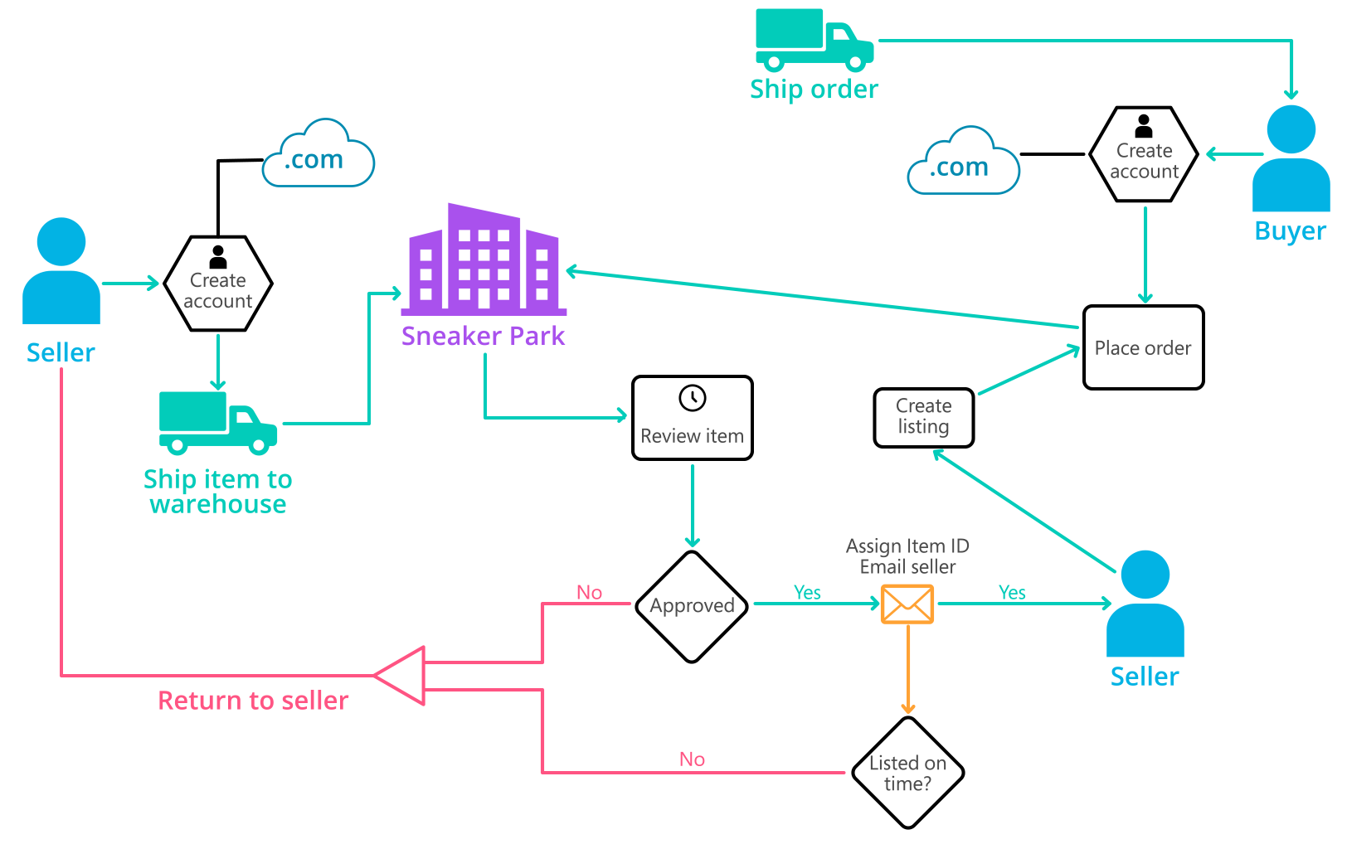
Background (cont’d)
Below you can see a diagram that will hopefully help you visualize some of SneakerPark's business processes. Keep in mind that it does not capture ALL processes and every nuance, but simply serves as another artifact to use in your project.

Slide 4
Step 1
Enterprise Data Catalog Part 1: Enterprise Data Model

Slide 5
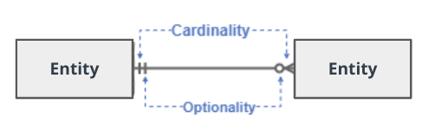
Create a conceptual data model that will provide SneakerPark with a holistic view of its data systems and help you grasp the organization's important entities and relationships, which will be instrumental as you move further in the project. You can use Lucidchart or any other diagramming tool of your choice, but please use the Crow’s Foot/IE Notation and please be sure to indicate both cardinality (the type of a relationship such as 1:N or N:N) and optionality (whether the relationship is optional or mandatory).

Slide 6
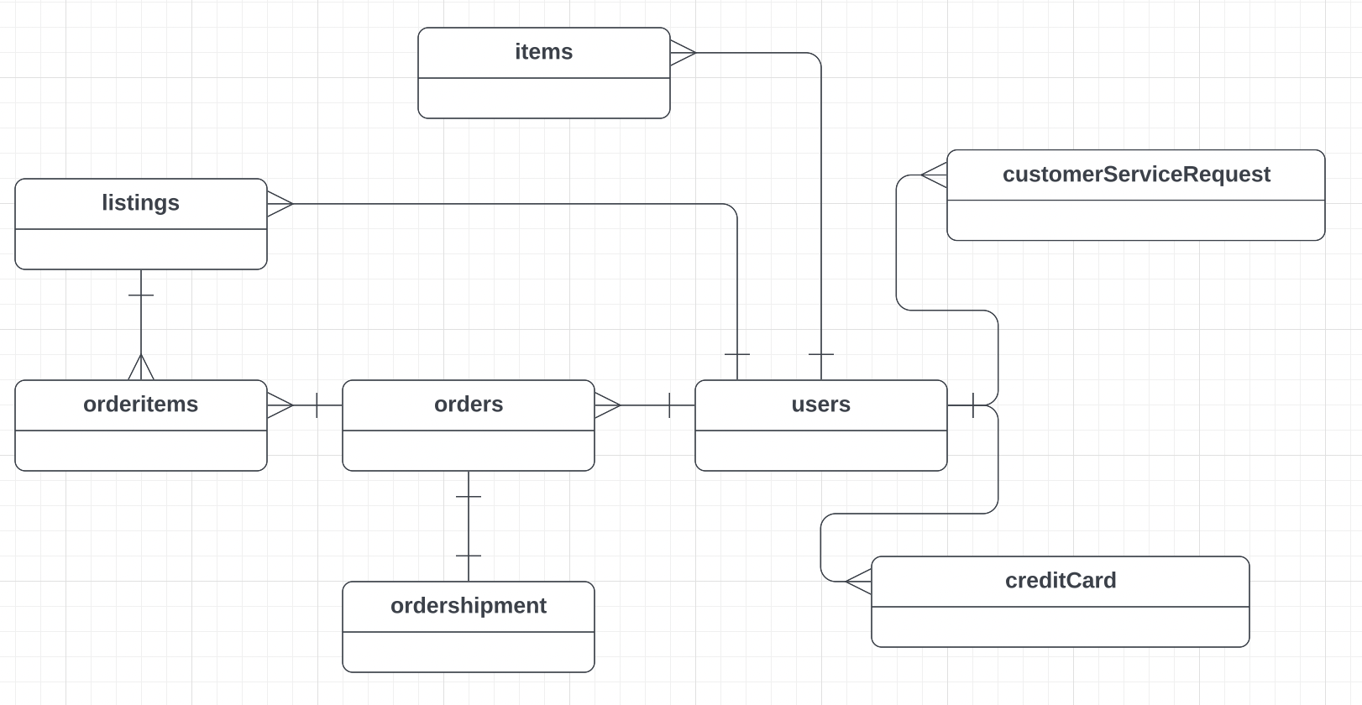

Slide 7
Step 2
Enterprise Data Catalog Part 2: Metadata

Slide 8
Create the first version of the Metadata Catalog by documenting the metadata from all systems in the "Data Dictionary" and the “Enterprise Data Catalog” tabs of the provided Sheets template.
Please note that you are required to fill out all fields in both tabs.
Note: All fields in "Data Dictionary" and the “Enterprise Data Catalog” tabs has been filled out.

Slide 9
Step 3
Data Quality
Part 1: Profiling and Cleansing

Slide 10
Profile the data to identify at least 3 data quality issues you see in the data. Also provide at least 1 data quality issue that you haven’t yet seen in the data, but can foresee occurring in the future. Based on the issues you’ve identified, come up with the data quality rule for each data quality issue, including for the one that you foresee.
Note: All fields in "Data Quality" tab has been filled out.

Slide 11
Step 4
Data Quality
Part 2: Monitoring

Slide 12
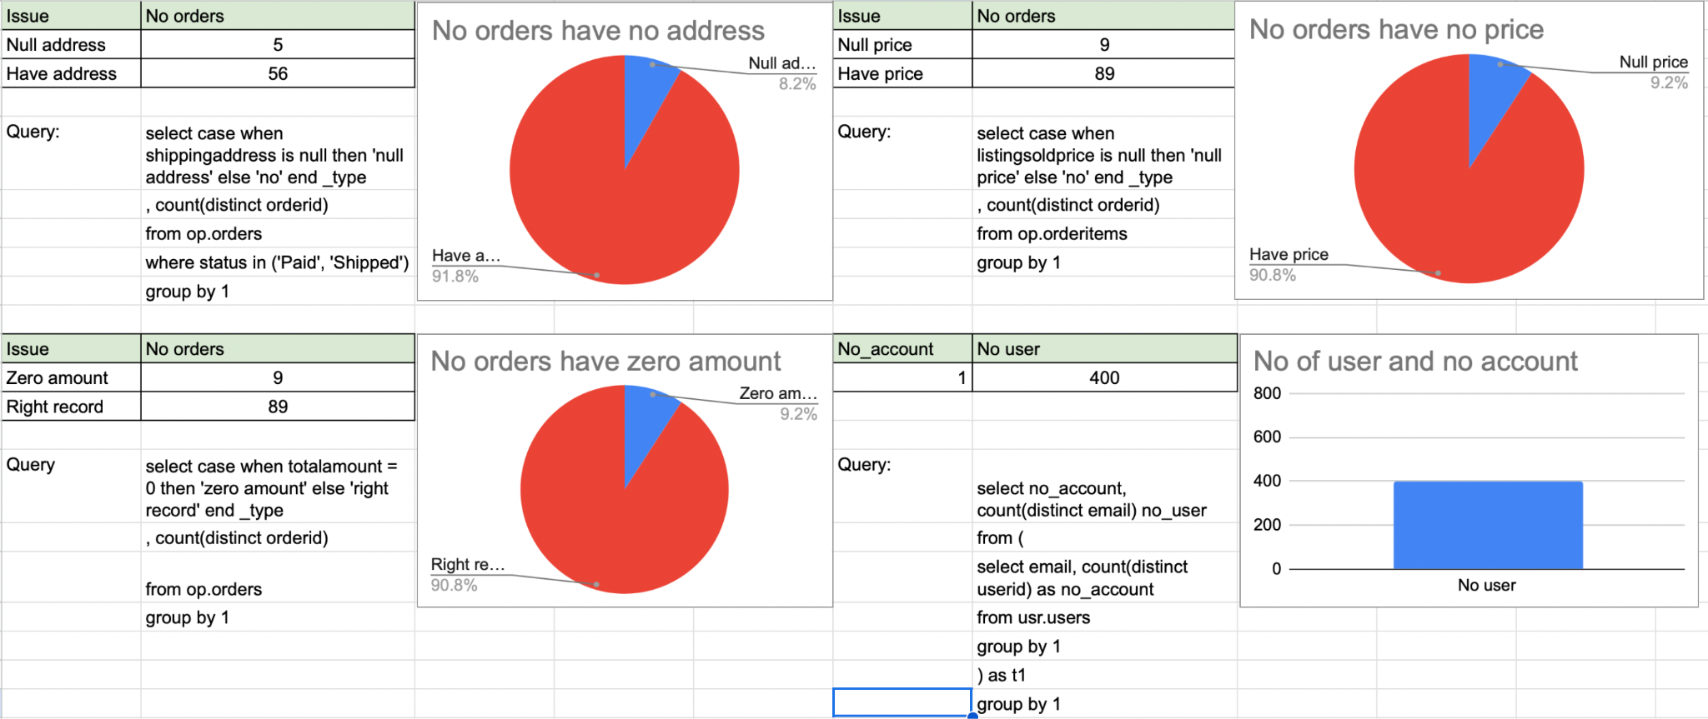
Using the metrics you've created in the last step, please create a mock-up of a data quality monitoring dashboard that will be used to monitor the data to ensure compliance with your data quality rules.
Please make sure to label your metrics clearly on your mock-up.

Slide 13
Step 5
Master Data Management
Part 1: MDM Architecture

Slide 14
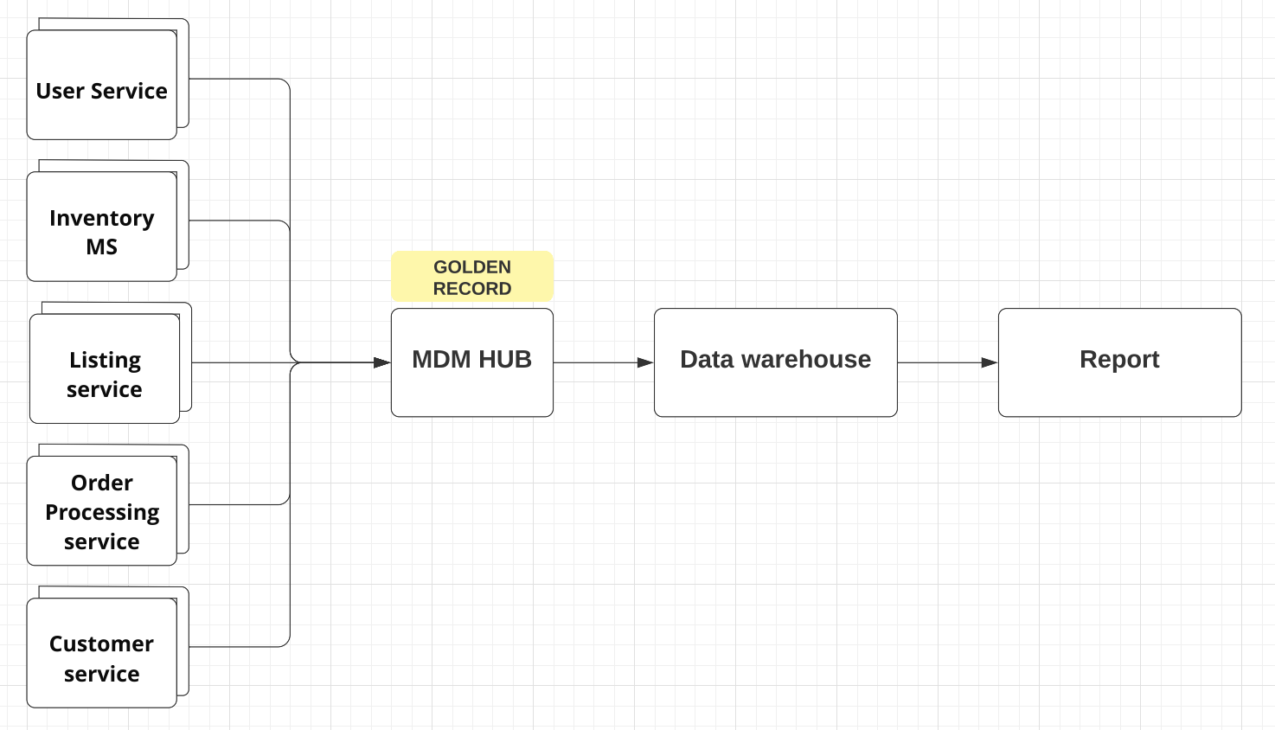
Based on what you’ve read about SneakerPark’s systems and business model, sketch out a proposed MDM implementation architecture, and write a detailed explanation of why you chose this specific approach.

Slide 15
Explanation:
Why consolidated architecture:
Simplified Data Management: A consolidated architecture centralizes and standardizes master data, simplifying data management processes.
Enhanced Scalability and Adaptability: With a consolidated architecture, the retail company can easily scale its operations and adapt to evolving business needs.

Slide 16
Step 6
Master Data Management
Part 2: Master Record

Slide 17
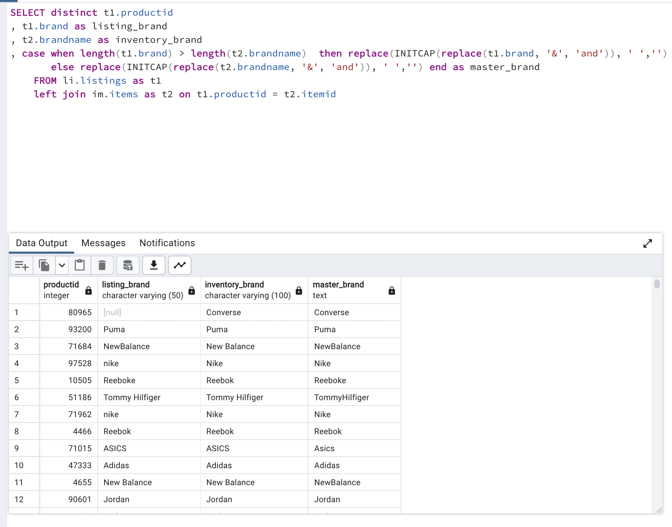
In this step, you will define a set of matching rules that will be used by the SneakerPark's MDM Hub to match item and customer entities between the company's different systems.
Rule 1: Match the brand name, based on the name with more characters then remove spaces and special characters.

Slide 18
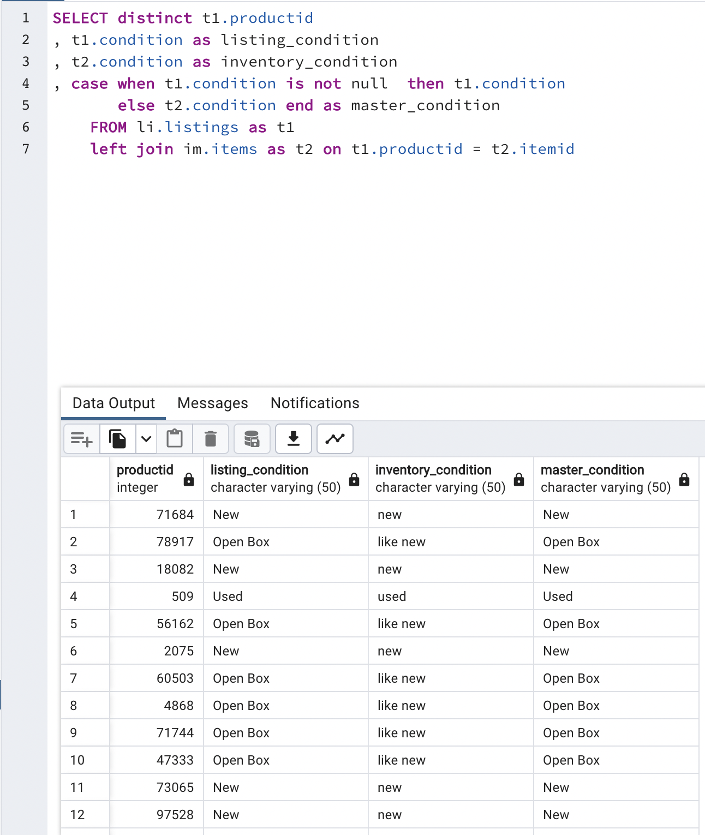
In this step, you will define a set of matching rules that will be used by the SneakerPark's MDM Hub to match item and customer entities between the company's different systems.
Rule 2: Using condition in listing table as master condition because it have no null and meaning very clear.

Slide 19
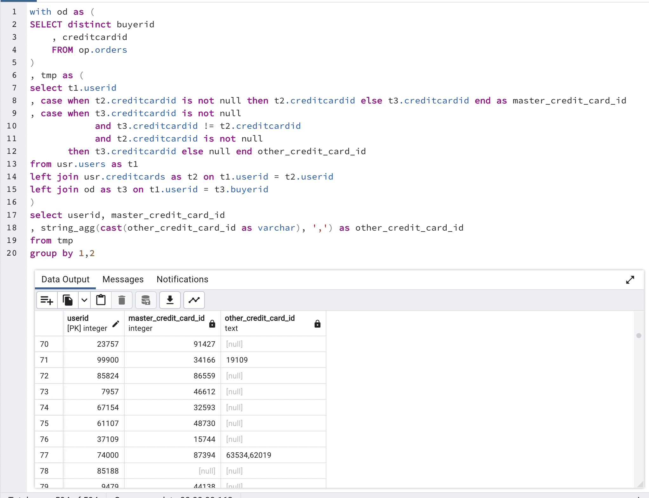
In this step, you will define a set of matching rules that will be used by the SneakerPark's MDM Hub to match item and customer entities between the company's different systems.
Rule 3: Match credit card of user, based on credit card id in creditcards table, if it null then using credit card has been used in orders table

Slide 20
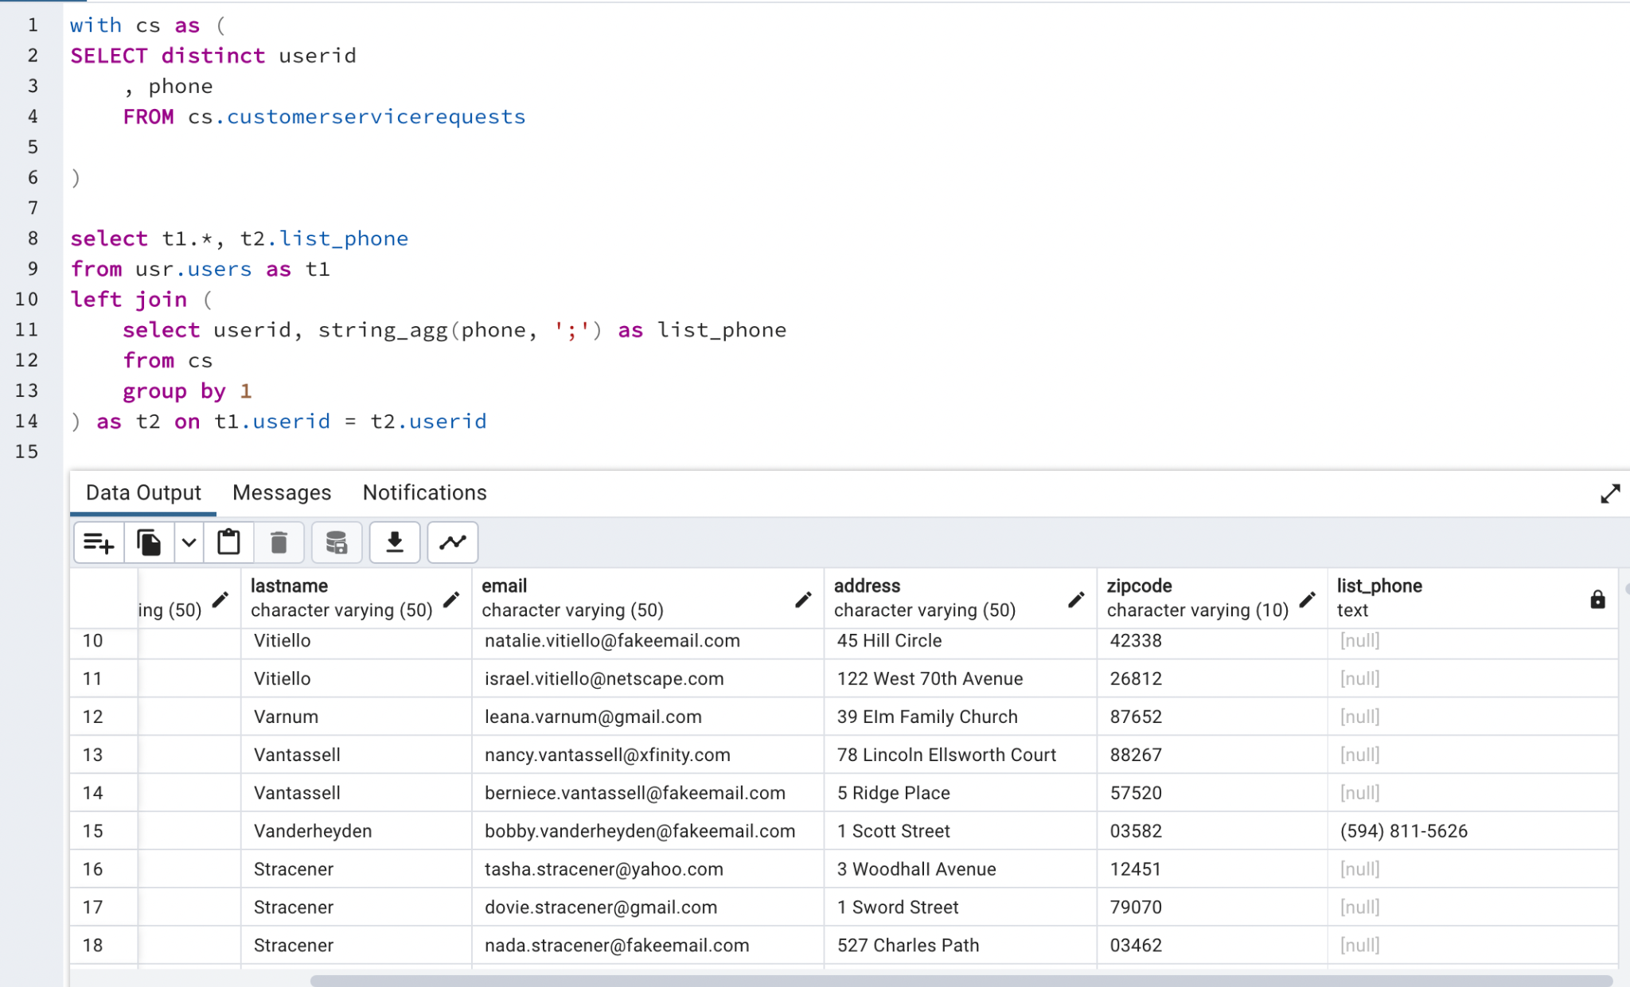
In this step, you will define a set of matching rules that will be used by the SneakerPark's MDM Hub to match item and customer entities between the company's different systems.
Rule 4: user table don’t have phone column so we will use data from customer service to add this data to user information

Slide 21
Step 7
Data Governance:
Roles and Responsibilities

Slide 22
Data owner (Jessica):
Alert a new issue that her faced and data architecture can improve data quality.
Give feedback about metadata, data architecture is a new role so he can not clearly understand every data so the with support from data owner the metadata will more useful and correct.
Developer:
Responsibility to apply a new validation rule to fix the data quality issue.
Data engineer:
DE will own the data flow of company so with a new flow (have master data stage before load to the data warehouse) data architecture need to work closely with DE to make sure can implement as well as tracking issue with master data.
This role is a new role so will prefer people have knowledge about ecomerce or retail. This knowledge will very helpful in situation company will have a lot of initiative in the future.

Slide 23
Standout Suggestions

Slide 24
Create a Business Glossary for SneakerPark and define common terms such as Item, Buyer, etc. Think and discuss how SneakerPark can improve on the consistency of the terms that its systems currently use. (You can use the “Business Glossary” tab of the same Sheets template you’ve been using for the other parts of this project to get you started.)
Document SneakerPark’s current naming conventions. Can you think of any improvements? (You can use the “Standard Naming Conventions” tab of the same Sheets template you’ve been using for the other parts of this project to get you started.) Some examples of Naming Conventions include;
Do not use spaces or special characters.
Use only LOWERCASE.
All identifier fields should end in “_id”.
Avoid acronyms and abbreviations.
Write SQL scripts for the matching rules that you’ve created in Step 6.

